Slide 1

176-VC-Carer-Manager
Third Presentation
Jack Sydenham
Nadvi Karawita
Zhihao Zhong
Stanley Chum
William Hu

Slide 2
Brief project description recap
Carer Manager Plus Pty Ltd has reached out to RMIT students for assistance in developing an administrative portal through which new care agencies can be easily added to and managed through their current cloud-based home care agency system by Carer Manager administrators.
The sponsor has taken RMIT students on board in previous years to work on this system and now expects a working prototype of this system to be developed tested by the end of the project's duration.

Slide 3
A Look Back at Our Original Goals
Initial Functionality Goals:
1
Admins must be able to login to the system using a created login form, and change their password using pre-defined form.
2
Admin Application must be able to access existing data on companies and employees within the Carer system.
3
Admins must be able to add new care agencies to their list of companies, along with specific data pertaining to said agency (such as charge rate or address)
4
Companies need to be able to create an employee in their company with default roles
Subsequent Functionality Goals:
1
Implement searchable addresses using Google Address Search API for administrator/employee details
2
Create additional and/or modify existing reference tables for pulling data to display on the frontend

Slide 4
Progress So Far
Completed first three sprints:
Sprint 1: Basic website construction with external library, based on JavaScript dev
Front-end :(Main pages, Details pages)
Sprint 2: Handle with Data fetching, inserting, updating, deleting to the pages we built
API utilisation: connecting the front-end to the back-end
Sprint 3: Finalise all the specific functionalities of the pages we built
(Address Search powered by Google, Custom Rules Apply, UI Optimisation, etc...)

Slide 5
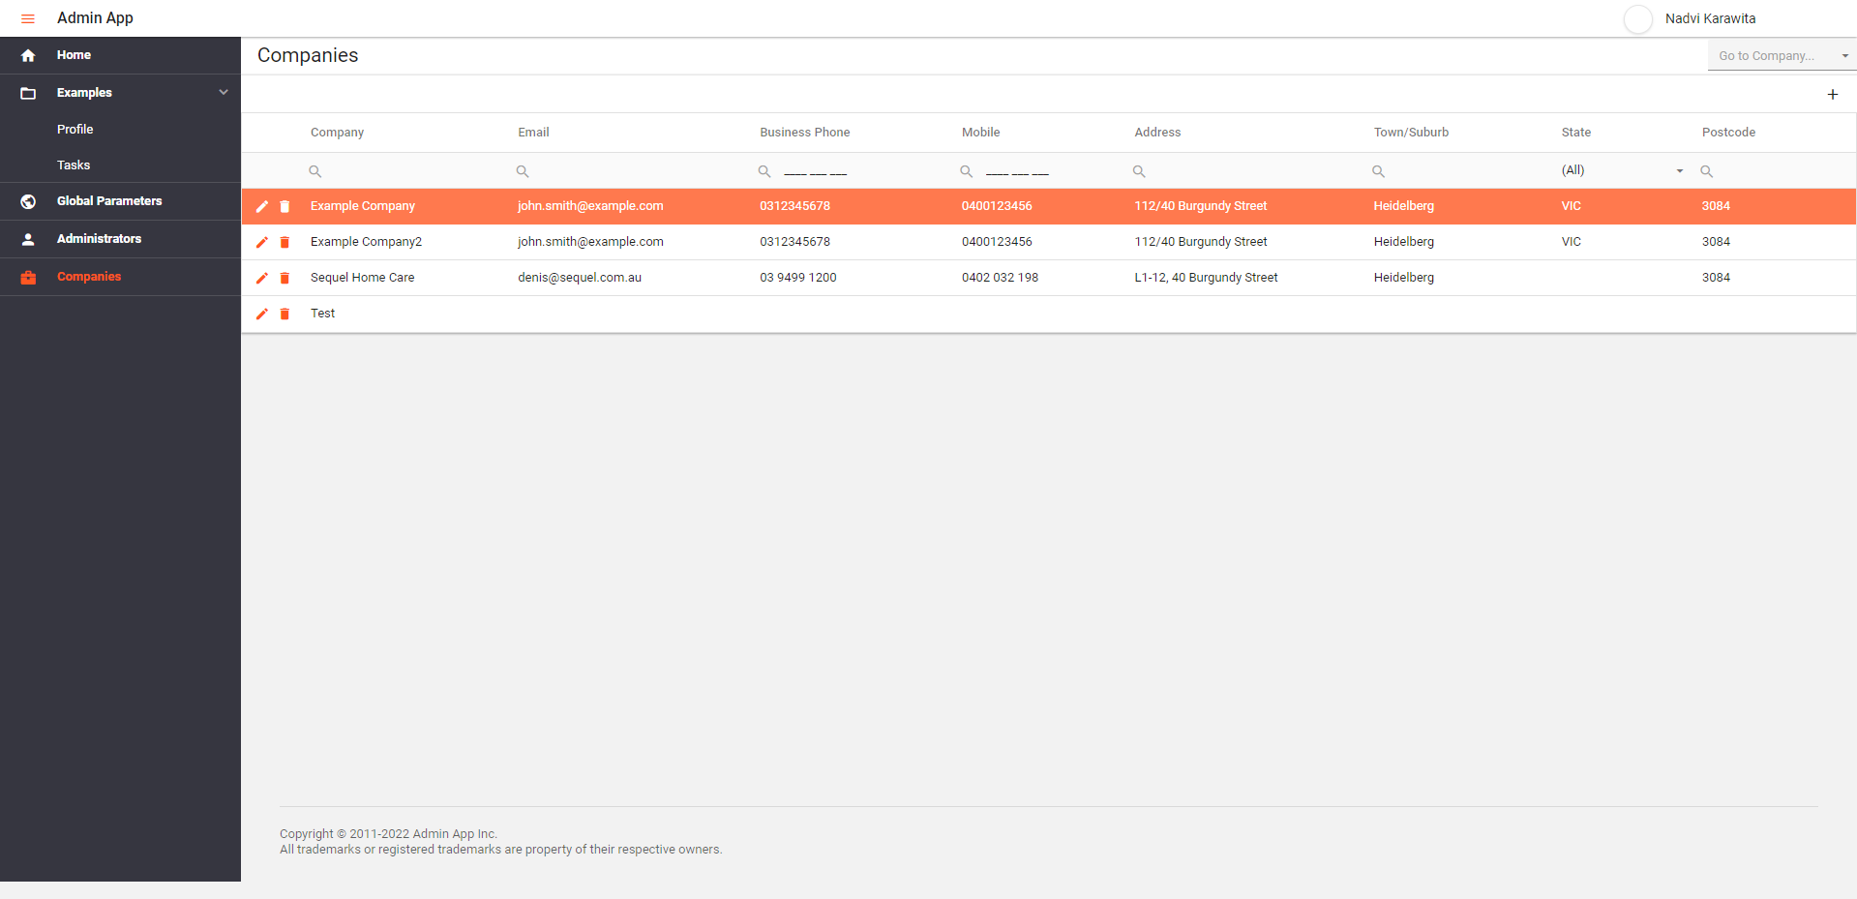
Frontend

Slide 6
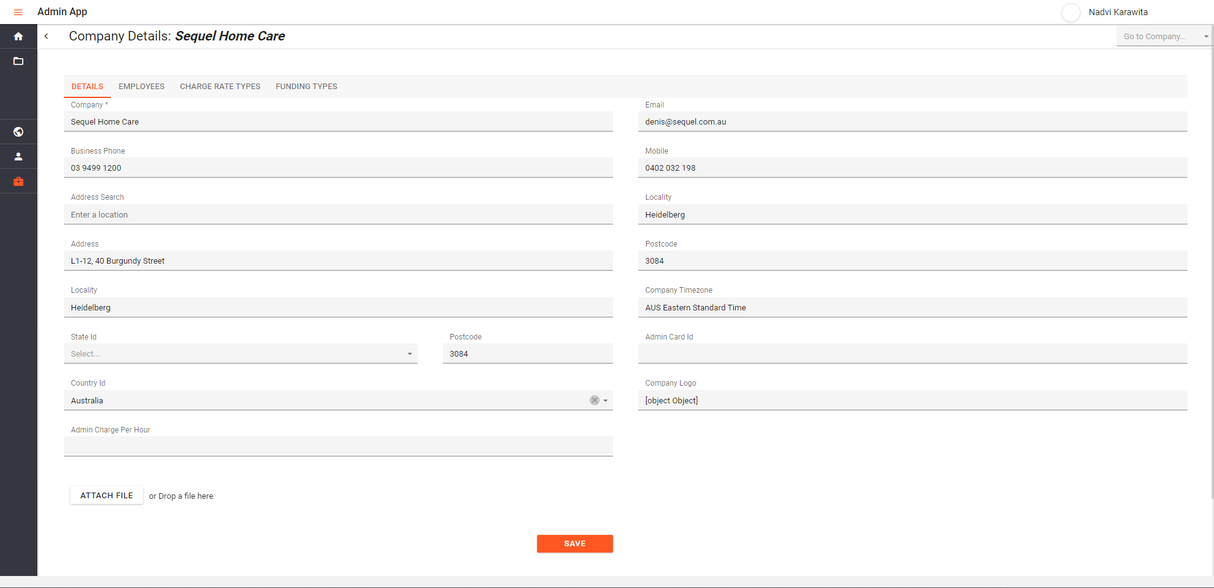
Frontend

Slide 7
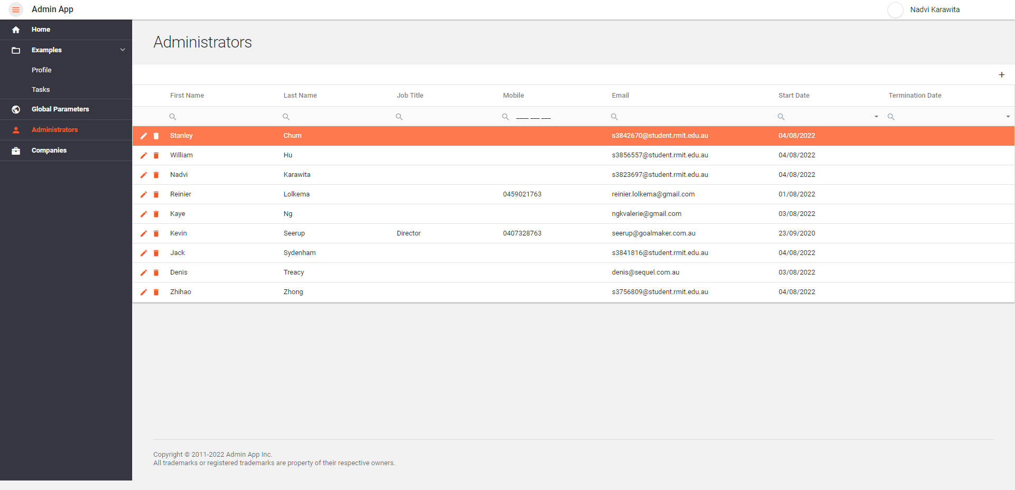
Frontend

Slide 8
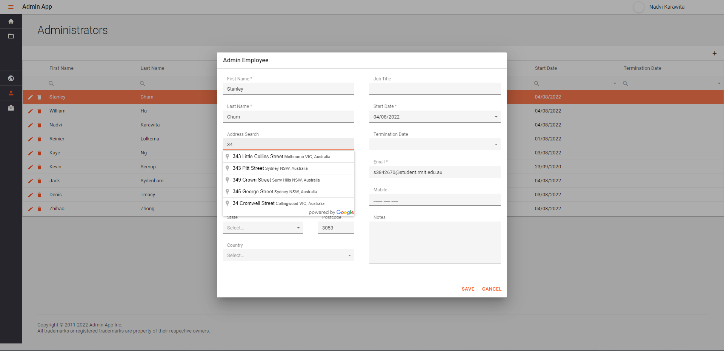
Frontend

Slide 9
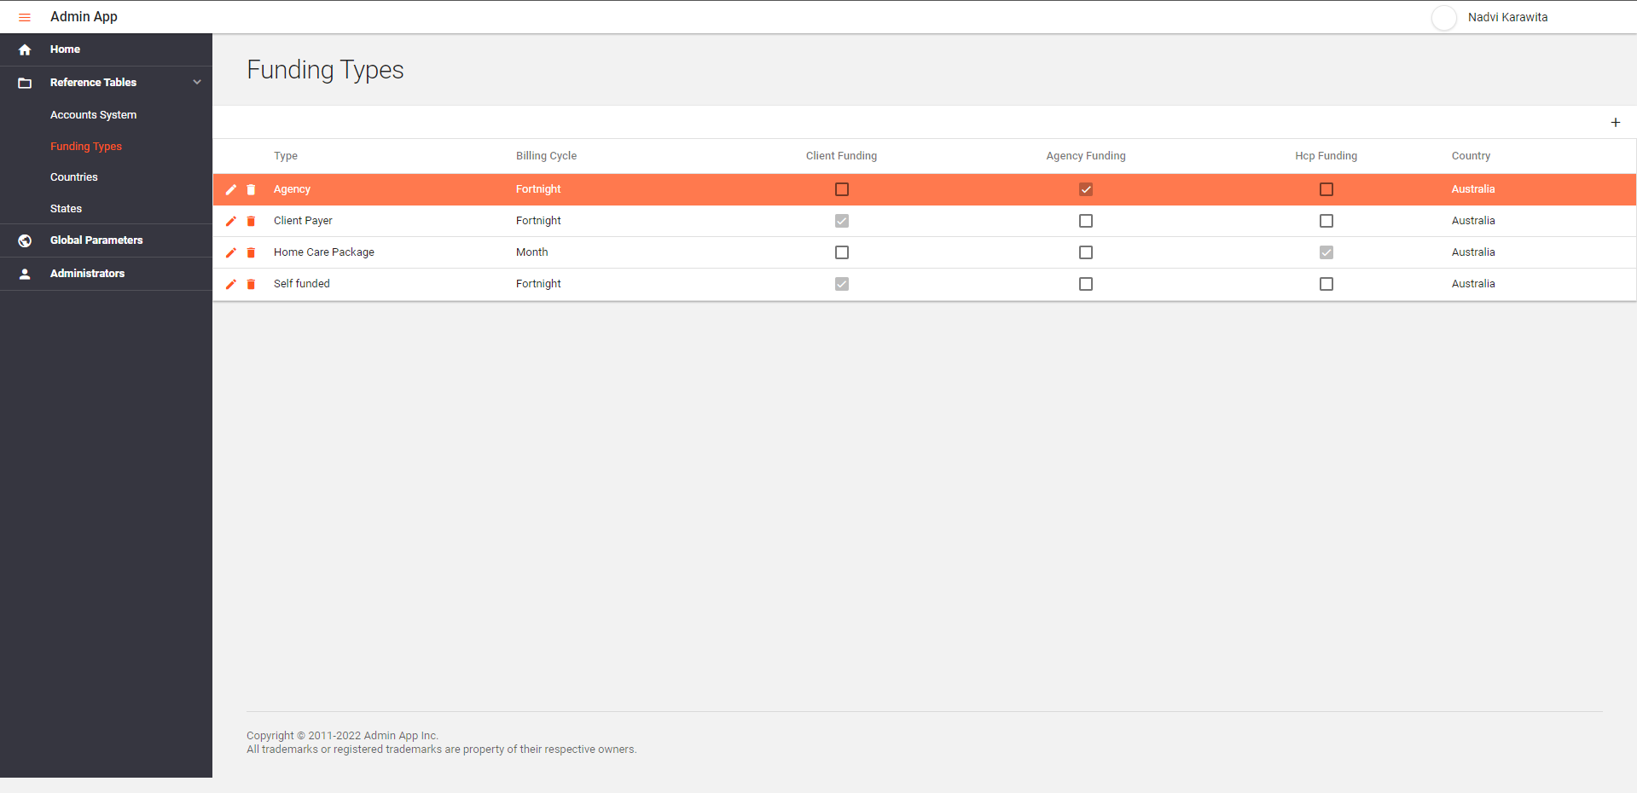
Frontend

Slide 10

Frontend

Slide 11
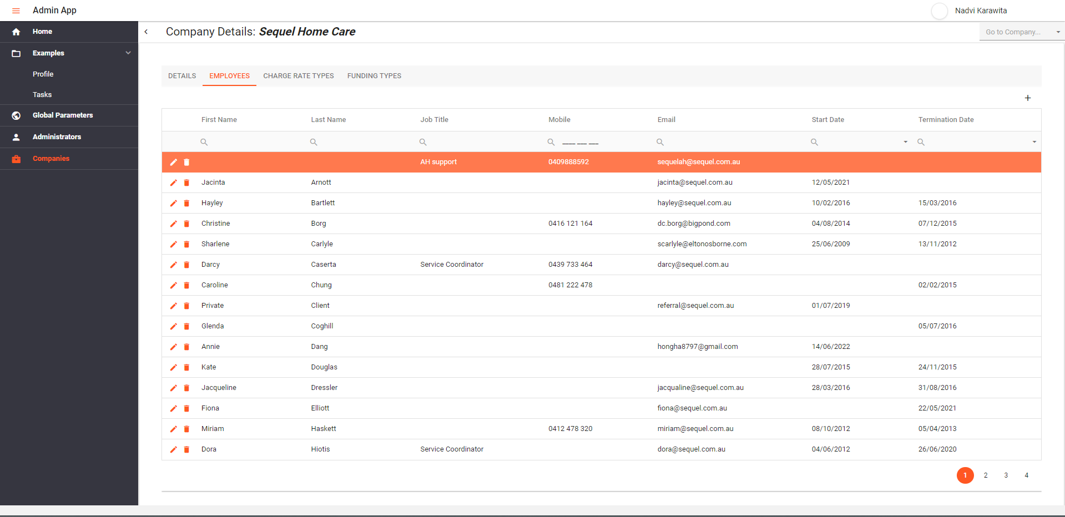
Frontend

Slide 12
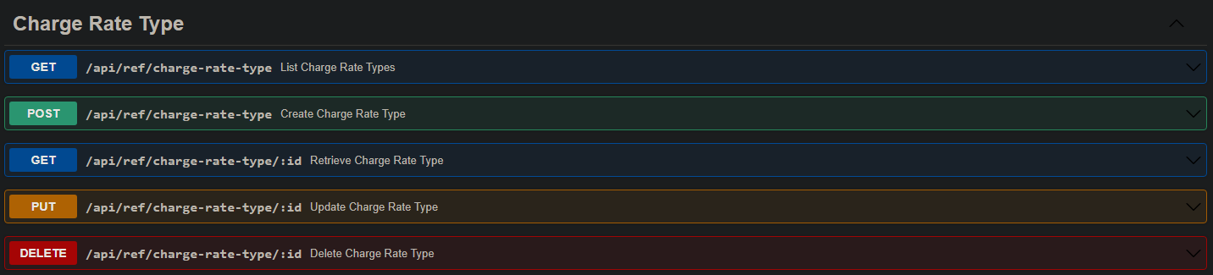
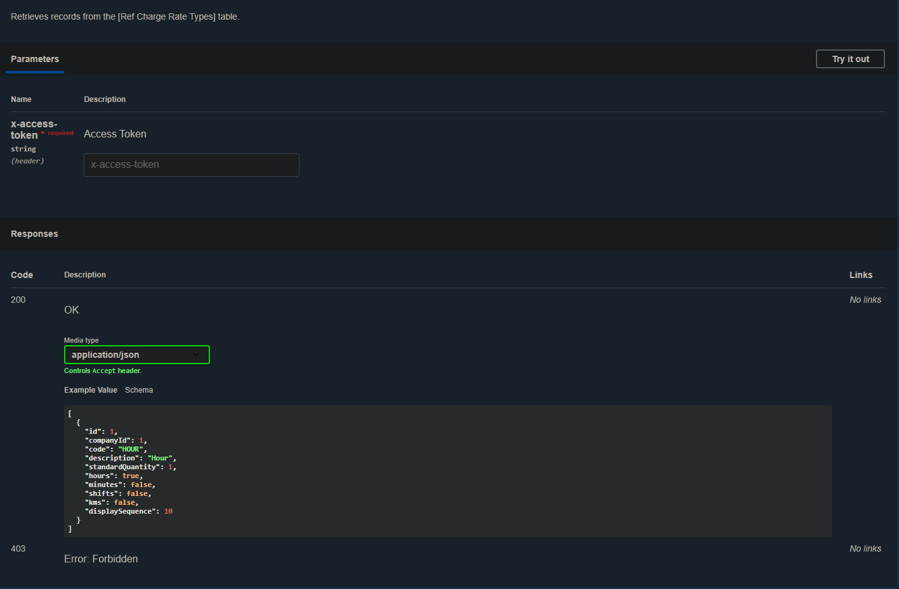
Backend
SWAGGER UI
Show images of backend maybe even the excel and google address implementations.

Slide 13
To do...
One sprint ongoing...
Sprint 4: Testing & New features:
Import Agencies/Customers/Employees details from excel to the database via the constructed website pages
Generate report regarding the details of companies

